Slide 1
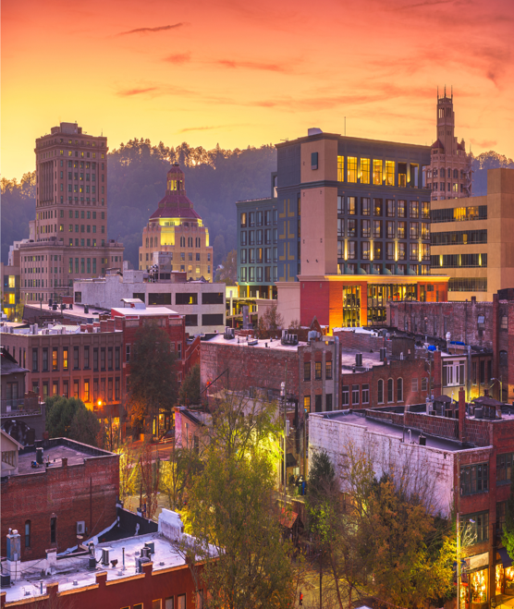
Welcome to Asheville!
A Symposium on Transforming the Foundational Postsecondary Experience
Teaching and Learning in Gateway Courses
First Year
Transfer
Analytics, Assessment, and Evaluation

Slide 2
A Symposium on Transforming the Foundational Postsecondary Experience
Workshop Rooms
Teaching and Learning in Gateway Courses
Burghley B
First Year
Vanderbilt
Transfer
Stuyvesant
Analytics, Assessment, and Evaluation
Burghley A
gardnerinstitute.org

Slide 3
1:00 - 1:30 pm Break
1:30 – 5:00 pm Concurrent Sessions
11:45 am – 12:05 pm Lunch
12:15 – 1:00 pm Plenary
9:45 – 11:45 am Workshop
9:30 – 9:45 am Break
8:30 – 9:30 am Plenary
Agenda
gardnerinstitute.org

Slide 4
A Symposium on Transforming the Foundational Postsecondary Experience
Information
Wifi:
HHonors.doubletree Password: DTCookie
(If you do not get a popup, go to another site like gardnerinstitute.org and you should get the pop up to enter the password)
Resources:
https://www.gardnerinstitute.org/symposium-resources
gardnerinstitute.org

Slide 5
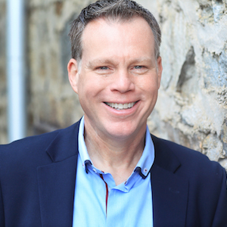
A Symposium on Transforming the Foundational Postsecondary Experience
Plenary
Transforming the Foundational Postsecondary Experience:
A Call to Action for All Postsecondary Educators
Drew Koch
CEO, Gardner Institute
gardnerinstitute.org

Slide 6
Setting the Context / Defining Terms
Supporting the Claim with Evidence
Why This Matters
Questions and Discussion
The Issue – A New Conceptual Framing
A Call for and Forms of Action
Sites for Work and Agency
Agenda
gardnerinstitute.org

Slide 7
What is the most pressing question you have about what you just heard?
What comment or feedback are you compelled to share?
The Framing Questions
gardnerinstitute.org

Slide 8
gardnerinstitute.org

Slide 9
What’s in a Name?
Transforming the
Foundational Postsecondary Experience
gardnerinstitute.org

Slide 10
What’s in a Name?
Transforming the
Foundational Postsecondary Experience
gardnerinstitute.org

Slide 11
What’s in a Name?
Transforming the
Foundational Postsecondary Experience
gardnerinstitute.org

Slide 12
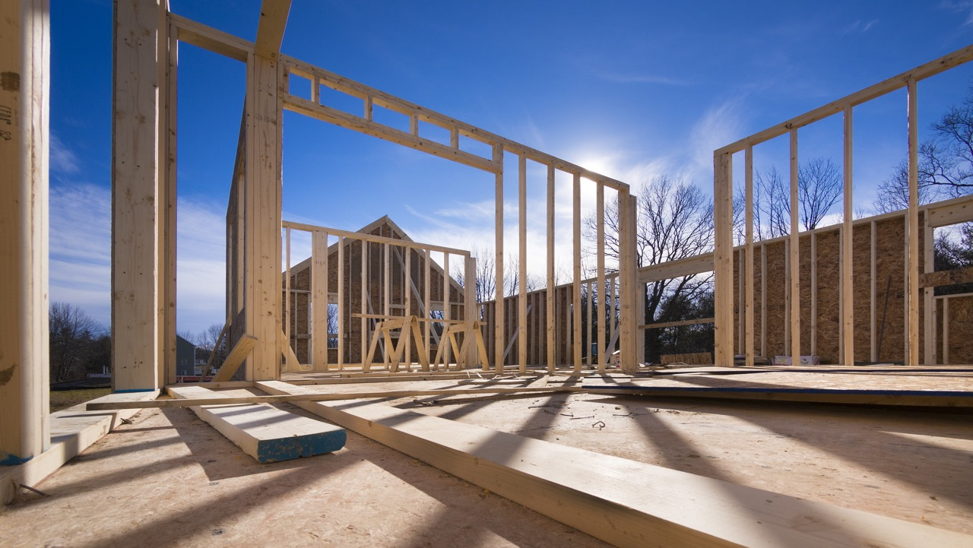
Reframe / Revise to Focus on The Foundational Postsecondary Experience

Slide 13
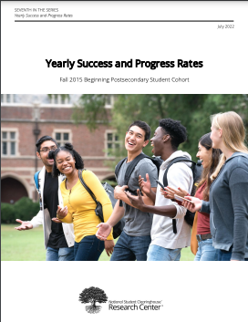
Supporting the Case in General
gardnerinstitute.org

Slide 14
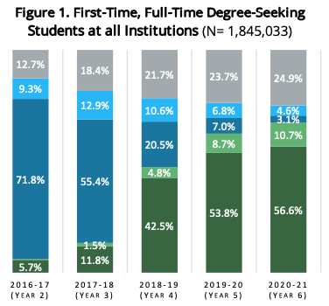
Supporting the Case in General
gardnerinstitute.org

Slide 15
56.6 % Graduation Rate Yields a 43.4% Non-Graduation Rate
Supporting the Case in General
gardnerinstitute.org

Slide 16
Supporting the Case in General
gardnerinstitute.org

Slide 17
Supporting the Case in General
gardnerinstitute.org

Slide 18
Supporting the Case in General
gardnerinstitute.org

Slide 19
Supporting the Case in General
gardnerinstitute.org

Slide 20
73.9% of the Loss Occurred During the Foundational Postsecondary Experience
(18.4 pp / 24.9 pp)
18.4% Not Enrolled Anywhere
24.9% Not Enrolled Anywhere
Supporting the Case in General
gardnerinstitute.org

Slide 21
56.5 % of all students graduate in 6 years
18.6% of all students are still enrolled somewhere in the 6th year
24.9% are not enrolled anywhere in the 6th year
This equates to nearly 460,000 students lost over 6 years
73.9% of that loss occurs during the Foundational Postsecondary Experience
gardnerinstitute.org

Slide 22
Limits of the NSC Study
gardnerinstitute.org

Slide 23
33 ”Retention Performance Management” Institutions
All 4-Year
Submitted data between 2011-12 and 2020-21 Academic Years
Over 299,000 individual student records
Can only look at enrollment / re-enrollment at initial institution
Supporting the Case with Disaggregated Data from the Gardner Institute
gardnerinstitute.org

Slide 24
Aggregate Retention and Graduation Rate Progression all First Year Students Cohort Years 2011-2020
28% Not Enrolled At Initial Institution
40.5% Not Enrolled At Initial Institution
53.3% Not Graduated from Initial Institution

Slide 25
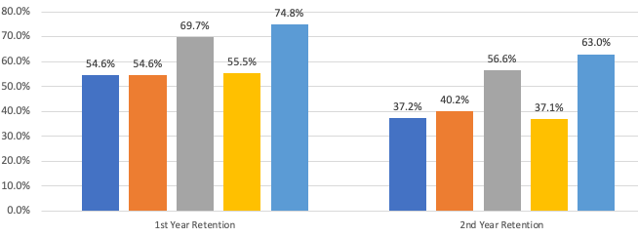
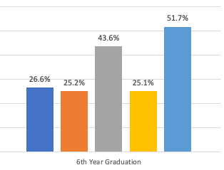
Retention and Graduation Rate Progression all First Year Students Cohort Years 2011-2020 – Disaggregated by Race/Ethnicity

Slide 26
Retention and Graduation Rate Progression all First Year Students Cohort Years 2011-2020 – Disaggregated by Race/Ethnicity

Slide 27
Retention and Graduation Rate Progression all First Year Students Cohort Years 2011-2020 – Disaggregated by Race/Ethnicity

Slide 28
Retention and Graduation Rate Progression all First Year Students Cohort Years 2011-2020 – Disaggregated by Race/Ethnicity

Slide 29
Retention and Graduation Rate Progression all First Year Students Cohort Years 2011-2020 – Disaggregated by Race/Ethnicity

Slide 30
Retention and Graduation Rate Progression all First Year Students Cohort Years 2011-2020 – Disaggregated by Race/Ethnicity
84% of loss occurred during Foundational Postsecondary Exper.
Approximately 45% Not at Original Institution
Approximately 62% Not at Original Institution
Approximately 75% Did Not Graduate from Original Institution

Slide 31
Retention and Graduation Rate Progression all First Year Students Cohort Years 2011-2020 – Disaggregated by Race/Ethnicity
Overall Percentage of Attrition During the Foundational Postsecondary Experience
85.6% of American Indian / Alaska Native
80% of Black / African American
77% of Hispanic / Latinx
84% of Native Hawaiian / Other Pacific Islander
76.6% of White
White Student Retention and Graduation

Slide 32
Retention and Graduation Rate Progression all First Year Students Cohort Years 2011-2020 – Disaggregated by Pell and First-Generation Statuses

Slide 33
Retention and Graduation Rate Progression all First Year Students Cohort Years 2011-2020 – Disaggregated by Pell and First-Generation Statuses

Slide 34
Retention and Graduation Rate Progression all First Year Students Cohort Years 2011-2020 – Disaggregated by Pell and First-Generation Statuses
Overall Percentage of Attrition During the Foundational Postsecondary Experience
74.0% First Generation
80.1% of Pell

Slide 35
Race/Ethnicity Matters
Family Income Matters
Starting Out Strong in the Foundational Postsecondary Experience Equates to Finishing Strong(er)
gardnerinstitute.org

Slide 36
Reconsider & Revise Action
Approximately 75% of all attrition occurs during the Foundational Postsecondary Experience (FPE)
An Equity Imperative – the Vast Majority of Students of Color and Low-Income Students Who Do Not Finish Leave During the Foundational Postsecondary Experience
The First Year Absolutely Matters
But So Does the Second Year
The Two Experiences Must Be Considered Collectively – as the Foundational Postsecondary Experience
gardnerinstitute.org

Slide 37
What’s in a Name?
Transforming the
Foundational Postsecondary Experience:
Innovation and Design So Every Student Can Graduate
gardnerinstitute.org

Slide 38
Innovation and Transformation
Reformative Innovation
Transformative Innovation
Formative Innovation
gardnerinstitute.org

Slide 39
Innovation and Transformation
Reformative Innovation
Transformative Innovation
Formative Innovation
gardnerinstitute.org

Slide 40
Innovation and Transformation
Reformative Innovation
Transformative Innovation
Formative Innovation
gardnerinstitute.org

Slide 41
Innovation and Transformation
Reformative Innovation
Transformative Innovation
Formative Innovation
gardnerinstitute.org

Slide 42
Innovating for Transformation
“Positive Restlessness”
gardnerinstitute.org

Slide 43
Innovating to Transform Institutions so Every Student Can Graduate: A Call to Action
To seriously move toward eliminating demographics and geography as destiny, postsecondary educators must transform the Foundational Postsecondary Experience
gardnerinstitute.org

Slide 44
Innovating to Transform Institutions so Every Student Can Graduate: Some Sites for Action
Gateway Courses
The Curriculum (General Education)
The First Year (as a linked continuum)
Transfer
Assessment / Evaluation
gardnerinstitute.org

Slide 45
Innovating to Transform Institutions so Every Student Can Graduate: Gardner Institute Action
gardnerinstitute.org

Slide 46
“Not everything that is faced can be changed. But nothing can be changed until it is faced” – James Baldwin
gardnerinstitute.org

Slide 47
What is the most pressing question you have about what you just heard?
What comment or feedback are you compelled to share?
The Framing Questions
gardnerinstitute.org

